Slide 1
"Always code as if the guy who ends up maintaining your code will be a violent psychopath who knows where you live."
John woods.

Slide 2

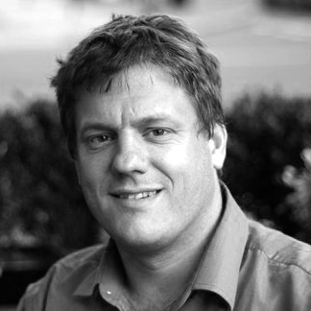
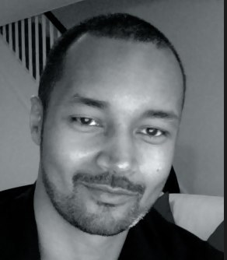
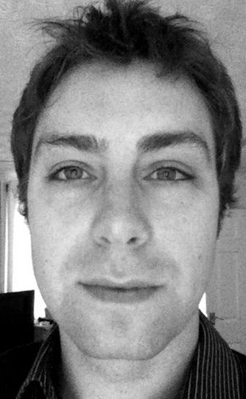
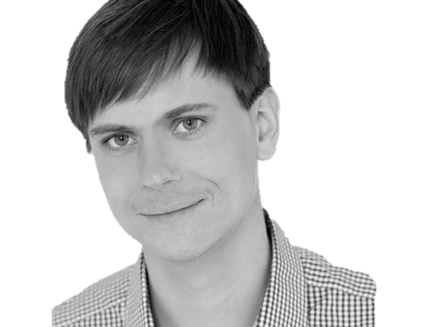

@riverglide
@andypalmer
@antonymarcano
@jmrtn
@pro_cessor

Slide 3

Ψ

Slide 4
Informatik
Keine Naturwissenschaft

Slide 5
Einstellungsähnlichkeit korreliert positiv mit DER interpersonellen Anziehung

Slide 6
Gleich und Gleich Einstellungsähnlichkeit korreliert positiv mit DER interpersonellen Anziehung gesellt sich gern

Slide 7
Die gravitationsbedingte vertikale Dislokation maliformer Agrarprodukte aus der Position ihrer Bio-Genese erfolgt in der Regel proxitrunkial

Slide 8

Der APFEL Fällt nicht Die gravitationsbedingte vertikale Dislokation maliformer Agrarprodukte aus der Position ihrer Bio-Genese erfolgt in der Regel proxitrunkial weit vom stamm

Slide 9
M a s c h i n e
Wir schreiben für die
anstatt für uns.

Slide 10
S
Open – Closed Principle
Liskov Substitution Principle
Interface Segregation Principle
Dependency Inversion Principle

Slide 11
S
O
Liskov Substitution Principle
Interface Segregation Principle
Dependency Inversion Principle

Slide 12
S
O
L
Interface Segregation Principle
Dependency Inversion Principle

Slide 13
S
O
L
I
Dependency Inversion Principle

Slide 14
S
O
L
I
D

Slide 15
S
O
L
I
D

Slide 16
S
O
L
I
D
Release-Reuse Equivalency Principle
Common Reuse Principle
Common Closure Principle
Acyclic Dependency Principle
Stable Abstractions Principle
Stable Dependencies Principle

Slide 17
S
O
L
I
D
RR
Common Reuse Principle
Common Closure Principle
Acyclic Dependency Principle
Stable Abstractions Principle
Stable Dependencies Principle

Slide 18
S
O
L
I
D
RR
CR
Common Closure Principle
Acyclic Dependency Principle
Stable Abstractions Principle
Stable Dependencies Principle

Slide 19
S
O
L
I
D
RR
CR
CC
Acyclic Dependency Principle
Stable Abstractions Principle
Stable Dependencies Principle

Slide 20
S
O
L
I
D
RR
CR
CC
AD
Stable Abstractions Principle
Stable Dependencies Principle

Slide 21
S
O
L
I
D
RR
CR
CC
AD
SA
Stable Dependencies Principle

Slide 22
S
O
L
I
D
RR
CR
CC
AD
SA
SD

Slide 23
S
O
L
I
D
RR
CR
CC
AD
SA
SD
Tell, don‘t ask
DRY
KISS
YAGNI

Slide 24
S
O
L
I
D
RR
CR
CC
AD
SA
SD
Tell, don‘t ask
DRY
KISS
YAGNI

Slide 25
S
O
L
I
D
RR
CR
CC
AD
SA
SD
Tell, don‘t ask
DRY
KISS
YAGNI

Slide 26
S
O
L
I
D
RR
CR
CC
AD
SA
SD
Tell, don‘t ask
DRY
KISS
YAGNI

Slide 27
S
O
L
I
D
RR
CR
CC
AD
SA
SD
Tell, don‘t ask
DRY
KISS
YAGNI

Slide 28
Separation
Machine
Domain
??

Slide 29
Empathie
Von Person zu Person

Slide 30
Empathy is the capacity to think and feel oneself into the inner life of another person
Heinz Kohut Psychoanalyst

Slide 31
Haltet EIN
Da kommt noch mehr!

Slide 32
Simple First
Paradigm-Commitment
Abstraction Segregation
Domain Relationship
Listening and Learning
Languages
Binary Dependency
Domain Language
Shared Under-standing
Eloquence
Patterns aren’t solutions
Weasel Word Removal

Slide 33
Simple First
Paradigm-Commitment
Abstraction Segregation
Domain Relationship
Listening and Learning
Languages
Binary Dependency
Domain Language
Shared Under-standing
Eloquence
Patterns aren’t solutions
Weasel Word Removal

Slide 34
Erst mal einfach
Simple First!
Richtig schwer!

Slide 35
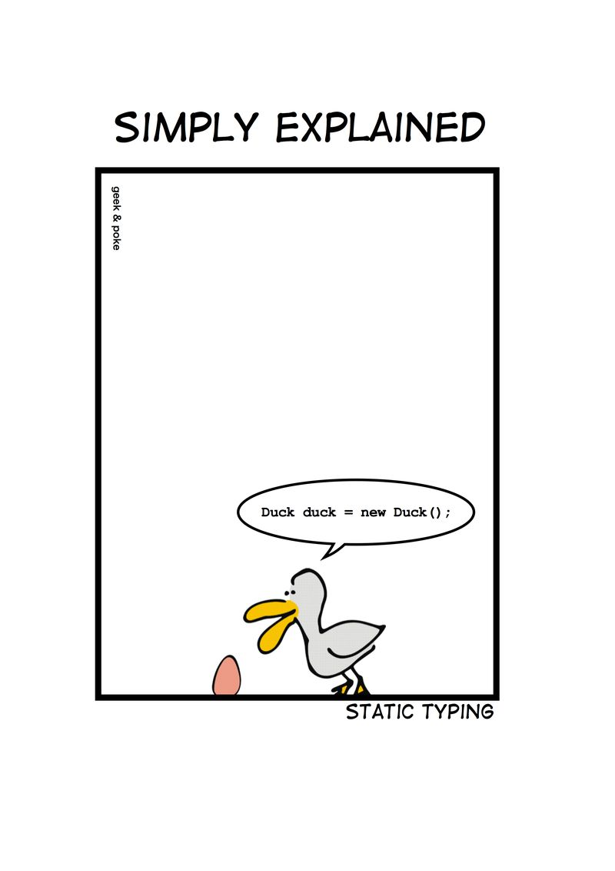
Notes:
Wie entscheidet man, ob etwas einfach ist?

Slide 36
C# Duck duck = new Duck();

Slide 37
Python duck = Duck()

Slide 38
C# - DRY var duck = new Duck();

Slide 39
Zug.un.glück
Es steht ein
bevor

Slide 40
Don’t ASK
Tell.
Or: The Law of Demeter

Slide 41
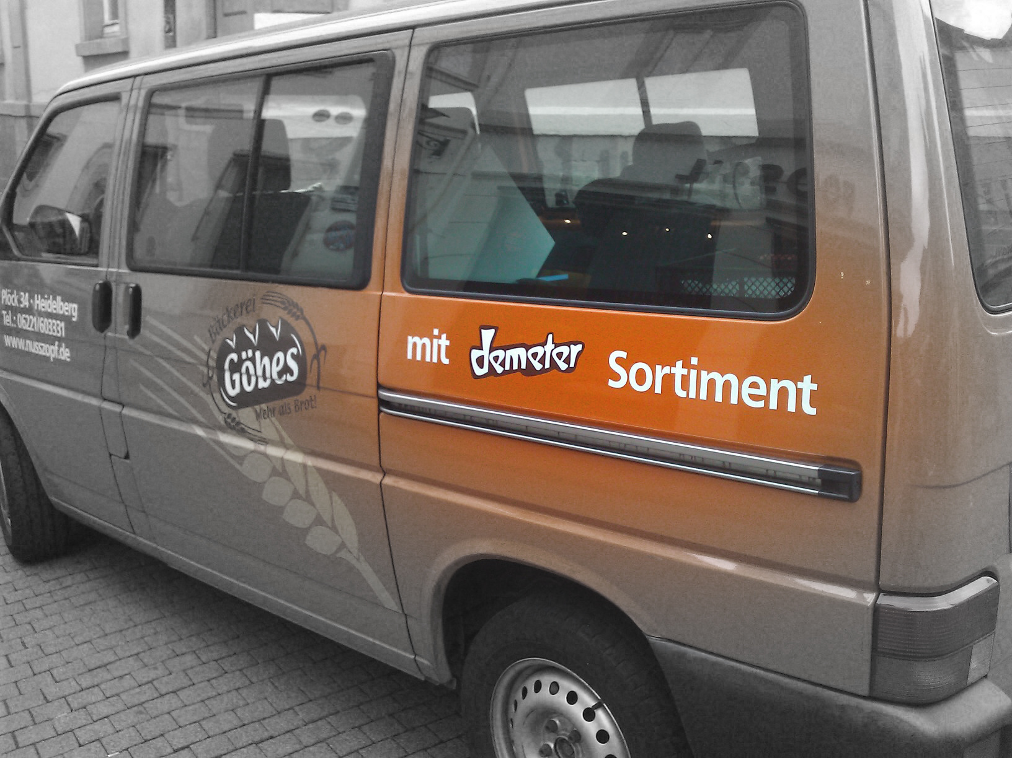

Slide 42
if(Customer.Email.Address.Value.IsValid) { Send(Customer.Email.Address, message); }

Slide 43
if(Customer.IsEmailValid()) { Send(Customer.Email.Address, message); }

Slide 44
Customer.Send(message)

Slide 45
Message.SendTo(Customer)

Slide 46
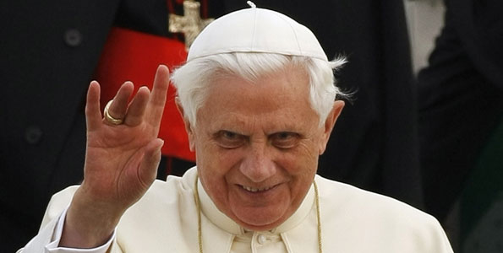
Don’t let a stranger touch your privates

Slide 47
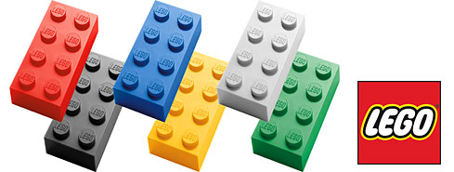
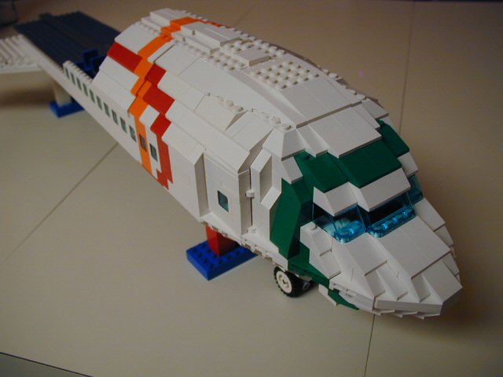
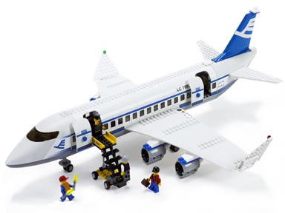
Size & Reuse

Slide 48
überraschungen
Keine
Was erwartest du?

Slide 49
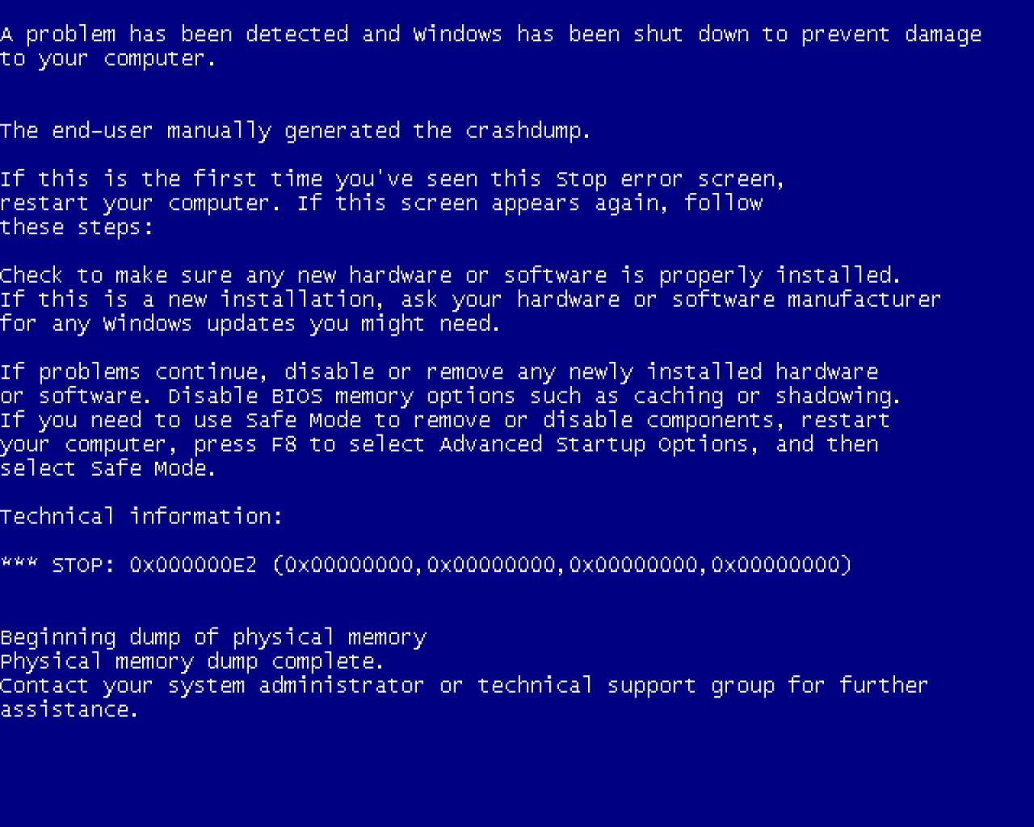
Notes:
Diese Folie ist ein Nullobjekt

Slide 50
Notes:
Diese Folie ist ein Nullobjekt

Slide 51
NullObjekte

Slide 52
Spüre deinen Code
Man sieht nur mit dem Herzen gut

Slide 53
public void Execute(MainViewModel mainViewModel) { mainViewModel.Done = () => Break(mainViewModel); mainViewModel.StartCounter(); } public void Break(MainViewModel model) { model.Color = 0x00DBFF.Rgb().Brush(); model.TimeLeft = 5.Minutes(); model.Done = () => Work(model); model.StartCounter(); } public void Work(MainViewModel model) { model.Color = 0x00DB00.Rgb().Brush(); model.TimeLeft = 25.Minutes(); model.Done = () => Break(model); model.StartCounter(); }

Slide 54
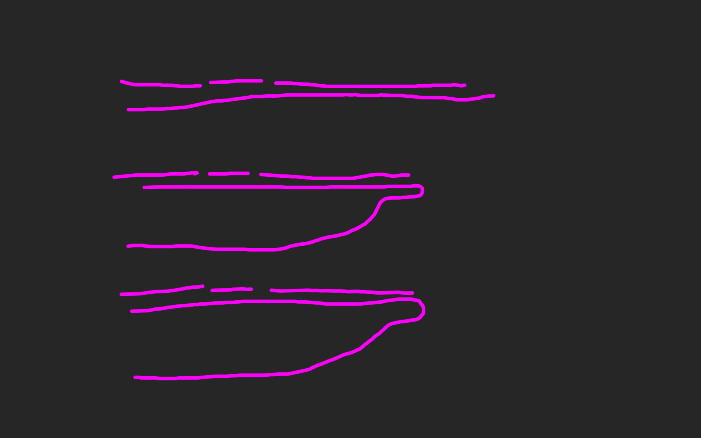
public void Execute(MainViewModel mainViewModel) { mainViewModel.Done = () => Break(mainViewModel); mainViewModel.StartCounter(); } public void Break(MainViewModel model) { model.Color = 0x00DBFF.Rgb().Brush(); model.TimeLeft = 5.Minutes(); model.Done = () => Work(model); model.StartCounter(); } public void Work(MainViewModel model) { model.Color = 0x00DB00.Rgb().Brush(); model.TimeLeft = 25.Minutes(); model.Done = () => Break(model); model.StartCounter(); }

Slide 59
def filter(markup): return add_twitter_names(markup) def add_twitter_names(markup): pattern = "@(\w+)" url = "https://twitter.com/" link = "<a href='%s\\1'>@\\1</a>" % url replacement = link return re.sub(pattern, replacement, markup) def home(entries): markup = create_page(entries) markup = filter(markup) return markup def main(): entries = Entries() if len(argv) > 1: date = argv[1] entries = entries.written_on(date) print home(entries)

Slide 60
metrik
Die einfachste
für die C-Familie

Slide 61
Signature Survey Datei (<loc>): { ; }

Slide 62
ExitWindowsFlags.cs (17): ;{{}} FullScreen.cs (10): {{{;}}} HexToColorExtension.cs (30): ;{{{;}{;}{;}}} Hibernate.cs (23): ;{{{}{}{;;;;}}} ICanBeSelected.cs (10): ;;{{;}} ICanStartAndStop.cs (12): ;{{{;;};;}} IExecute.cs (10): ;;{{;}} IHaveGotTheTime.cs (9): ;{{{;}}} IntToTimespanExtension.cs (26): ;{{{;}{;}{;}}} InvisibilityConverter.cs (20): ;;;;{{{;}{;}}} IShutdownTheSystem.cs (7): {{;}} IWindowsFunctions.cs (9): {{;;;}} KeyExtension.cs (17): ;{{{;}{;}}} Lock.cs (20): ;{{{}{}{;}}} LogOff.cs (21): ;{{{}{}{;;}}} MainViewModel.cs (103): ;;;;;;{{;;;;;;;;;{;;;}{{;}{;}}{{;}{;}}{{;}{;}}{{;}{;}}{;;;;;}{;;}{;}{;{;;}}{;}{;;}{;;;;}}} MainWindow.xaml.cs (42): ;;;;;{{;{;;;}{{;}}{;;;}{;;}}} MenuItemExtension.cs (17): ;;;{{{{;}}}} MouseWheelGesture.cs (56): ;{{{}{}{;;}{{{};}}{{{};}}{{{};}}{{{};}}{;;;{;;;;}}}} MutuallyExclusiveCheckBoxes.cs (42): ;;{{{;}{;}{;;;;}{;}{;}{;}}} PlaySound.cs (23): ;;;;;{{{{;}{;}}}} PomodoroTimer.cs (33): ;;;{{{;;}{;;;;}{;;;;}}} RegisterShutdownEvent.cs (12): ;{{{;}}} RegisterTimeoutEvent.cs (23): ;{{{;;}{;}{;}}} ResetTimer.cs (21): ;;;{{;{;}{;}}} Restart.cs (21): ;{{{}{}{;;}}} RestartTimer.cs (21): ;;{{;{;}{;;}}} SetColor.cs (37): ;{{;{;;;;;;}{;;}}} SetTime.cs (18): ;;{{{;}{;}}} Shutdown.cs (21): ;{{{}{}{;;}}} ShutdownReason.cs (47): ;{{}} Sleep.cs (23): ;{{{}{}{;;;;}}} Start.cs (10): {{{;}}} Stop.cs (10): {{{;}}} TimeSpanExtensions.cs (12): ;{{{;}}} Toggle.cs (13): ;{{{;;}}} ViewCommand.cs (15): ;;{{{;;}{;}}} ViewModel.cs (39): ;;;{{{;;}{{};}{{};;;}}} ViewModelBaseWeasel.cs (29): ;;{{;{;;;}{;;;}}} VisibilityConverter.cs (20): ;;;;{{{;}{;}}} Wheel.xaml.cs (20): ;;;{{{;}{;;}}} WheelDirection.cs (9): {{}}

Slide 63
LogOff.cs (21): ;{{{}{}{;;}}} MainViewModel.cs (103): ;;;;;;{{;;;;;;;;;{;;;}{{;}{;}}{{;}{;}}{{;}{;}} MainWindow.xaml.cs (42): ;;;;;{{;{;;;}{{;}}{;;;}{;;}}} MenuItemExtension.cs (17): ;;;{{{{;}}}} MouseWheelGesture.cs (56): ;{{{}{}{;;}{{{};}}{{{};}}{{{};}}{{{};}}{;;;{ MutuallyExclusiveCheckBoxes.cs (42): ;;{{{;}{;}{;;;;}{;}{;}{;}}}

Slide 64
philosophie
Code
Und Maximen

Slide 65
>>> import this

Slide 66
If the implementation is hard to explain, it's a bad idea.
python

Slide 67
Zuhören
Richtig
und dabei lernen!

Slide 68
Wir brauchen einen Automocker.

Slide 69


Slide 70
Diese klasse ist schwer zu testen.

Slide 72
Das gleiche sagen
Shared Understanding
vom selben Elephanten

Slide 73
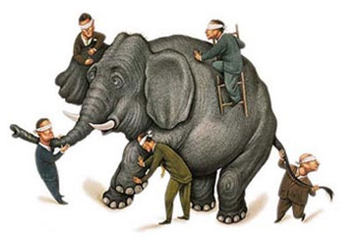

Slide 74
Simple First
Paradigm-Commitment
Abstraction Segregation
Domain Relationship
Listening and Learning
Languages
Binary Dependency
Domain Language
Shared Under-standing
Eloquence
Patterns aren’t solutions
Weasel Word Removal

Slide 75
IM PARADIGMA BLEIBEN
Unabhängig von der Sprache
Und es verstehen

Slide 76
Objekte Funktionen

Slide 77
Relationen Dokumente

Slide 78
Sprachen
Polyglott
C#, F#, Prolog, Io, Haskell, Brainfuck, Python, Ruby, Javascript, Lisp, Smalltalk, C++, C, Java, Groovy, Scala, Clojure, Perl, R

Slide 79
https://github.com/cessor/refuctoring

Slide 80
private static TimeSpan Transform(this IEnumerable<int> digits) { int result = 0; var r = digits.ToList(); for (int j = 0; j < r.Count; j++) { int i = (int)Math.Pow(60, j / 2); int rTimesI = r[r.Count - j - 1] * i; result += (j % 2 == 1) ? rTimesI * 10 : rTimesI; } return TimeSpan.FromSeconds(result); }

Slide 81
private static TimeSpan Transform(this IEnumerable<int> digits) { var secondsPerUnit = new [] { 1,10,60,600,3600,36000 }; return digits .Reverse() .Zip(secondsPerUnit, (digit, unit) => digit * unit) .Sum() .Seconds(); }

Slide 82
“You can call it beautiful code when the code also makes it look like the language was made for the problem”
Ward cunningham.

Slide 83
public class Quicksort { public static int[] Sort(int[] array) { int[] a = new int[array.Length]; array.CopyTo(a, 0); Sort(0, array.Length - 1, ref a); return a; } private static void Sort(int links, int rechts, ref int[] daten) { if (links >= rechts) return; int teiler = Divide(links, rechts, ref daten); Sort(links, teiler - 1, ref daten); Sort(teiler + 1, rechts, ref daten); } private static int Divide(int left, int right, ref int[] data) { int leftpos = left; int rightpos = right - 1; int pivot = data[right]; do { while (data[leftpos] <= pivot && leftpos < right) leftpos++; while (data[rightpos] >= pivot && rightpos > left) rightpos--; if (leftpos >= rightpos) continue; Swap(leftpos, rightpos, ref data); } while (leftpos < rightpos); if (data[leftpos] > pivot) { Swap(leftpos, right, ref data); } return leftpos; } private static void Swap(int left, int right, ref int[] data) { int z = data[left]; data[left] = data[right]; data[right] = z; } }

Slide 84
let rec quicksort (list:int list) = match list with | [] -> [] | head::tail -> let smaller,larger = List.partition (fun y -> y <= head) tail quicksort smaller @ [head] @ quicksort larger

Slide 85
“Clean code reads like well-written prose”
Grady Booch

Slide 86
Natürliche
Gesprochene,
Sprache

Slide 87
var date = new DateTime (2012, 4, 14, 16, 32, 18, 500);

Slide 88
var start = 14.April(2012).At(8.PM()); var end = 8.Hours().Later(start);

Slide 89
Sprachfertigkeit
Eloquenz
Eine Sprache richtig sprechen

Slide 90
Wenn du mir erklären kannst, was da passiert, wieso steht das da dann nicht?

Slide 91
[Test] public void ShouldConvertAnEvenNumberOfDigitsToATimespan() { // Arrange var bytes = new byte[] { 0, 0, 1,5, 0,5 }; var expected = new TimeSpan(0, 0, 15, 5, 0); // Act var actual = Transform(bytes); // Assert actual.Should().Equal(expected); }

Slide 92
When.IType(1, 5, 0, 5).And() .TransformTheDigits() .Then().TheResult().Should().Equal( 15.Minutes().And(5.Seconds()) );

Slide 93
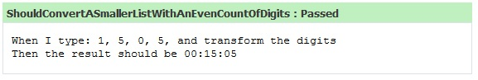

Slide 94
Simple First
Paradigm-Commitment
Abstraction Segregation
Domain Relationship
Listening and Learning
Languages
Binary Dependency
Domain Language
Shared Under-standing
Eloquence
Patterns aren’t solutions
Weasel Word Removal

Slide 95
Abstraktion
Trennen von Einzelheiten
in Domäne und Maschine

Slide 96
for int i=0; GetCustomer

Slide 97
Exceptionell,
Ist etwas
Wenn du es erwartest?

Slide 98
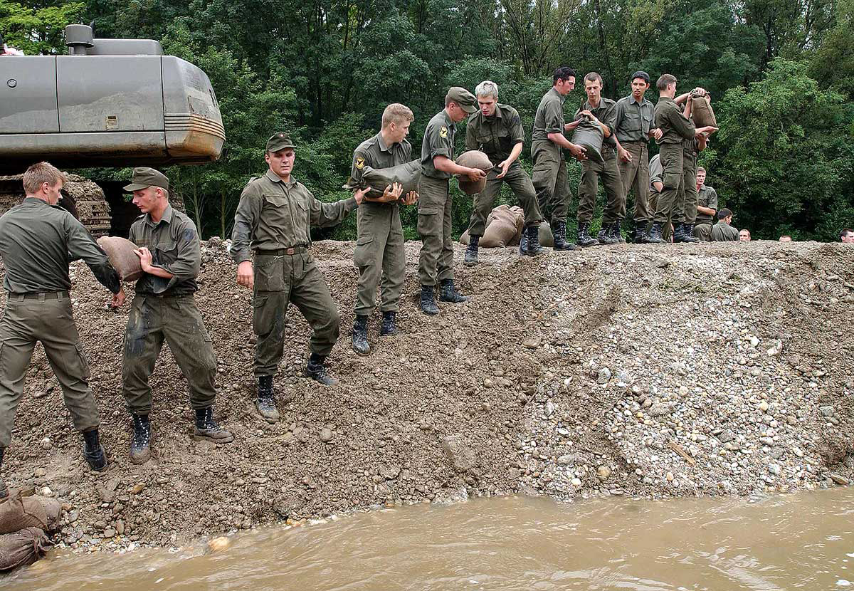

Slide 99
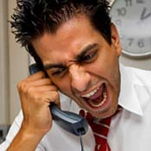
Complaints
Beschwerden
Wenn ein Problem besteht

Slide 100
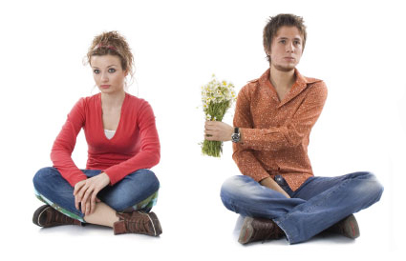
Apologies
Entschuldigung
Wenn es verzeihbar ist

Slide 101
Binäre Abhängigkeit
x = 1 + 2
Meist reicht das.

Slide 102
Dependent-on Components
Interactions
DATA

Slide 103
Event Based Components
EBC
Pins
Board

Slide 104
Imports Parameter Binäre Bäume

Slide 105
Entwurfsmuster
Design Patterns
Sind keine Lösung

Slide 106
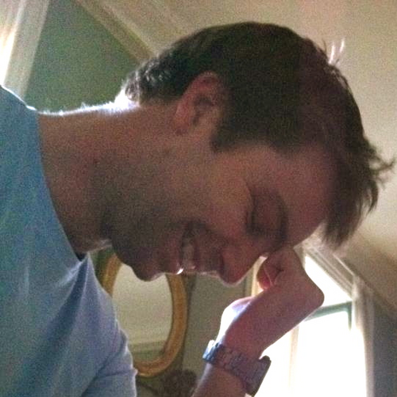
https://twitter.com/#!/jmrtn http://jmrtn.com/notes/2012/02/17/design-patterns.html

Slide 107
Simple First
Paradigm-Commitment
Abstraction Segregation
Domain Relationship
Listening and Learning
Languages
Binary Dependency
Domain Language
Shared Under-standing
Eloquence
Patterns aren’t solutions
Weasel Word Removal

Slide 108
DomänenBEZUG
Wenn du darüber sprichst…
…ist es wahrscheinlich wichtig

Slide 109
War stories
Also ich hab da…

Slide 110
“Also ich hab da so ne Software”

Slide 111
“Also ich hab da so ne Software, die bearbeitet so Bilder.”

Slide 112
“Also ich hab da so ne Software, die bearbeitet so Bilder. Aber ich hab da so zwei viel zu große Klassen.”

Slide 113
“Also ich hab da so ne Software, die bearbeitet so Bilder. Aber ich hab da viel zu große Klassen. Und ich reiche da so ein Bytearray rum.”

Slide 114
“Also ich hab da so ne Software, die bearbeitet so Bilder. Aber ich hab da viel zu große Klassen. Und ich reiche da so ein Bytearray rum. Und das wird dann von allen bearbeitet.”

Slide 115
“Also ich hab da so ne Software, die bearbeitet so Bilder. Aber ich hab da viel zu große Klassen. Und ich reiche da so ein Bytearray rum. Und das wird dann von allen bearbeitet. Das ist schon ziemlich kompliziert…”

Slide 117
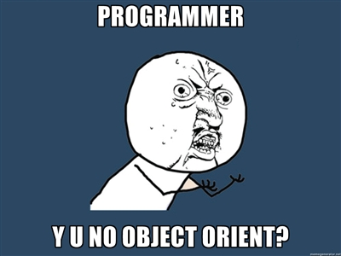

Slide 118
Bilder sind keine ByteArrays

Slide 119
Email Adressen sind keine Strings

Slide 120
TinY TYpes

Slide 121
Dinge müssen nicht können aber sie können sein

Slide 122
Email InvalidEmail

Slide 123
Polymorphismen Typen

Slide 124
Domänensprache
Ubiquitous Language
Gegen Babylonische Sprachverwirrung

Slide 125
Systemische Metapher Klare Namen

Slide 126
Simple First
Paradigm-Commitment
Abstraction Segregation
Domain Relationship
Listening and Learning
Languages
Binary Dependency
Domain Language
Shared Under-standing
Eloquence
Patterns aren’t solutions
Weasel Word Removal

Slide 127
Running
Never Touch a
System

Slide 128
Running
Never Change a
System

Slide 129
Changing
Always run a
System

Slide 131
Blind men and the elephant John Godfrey Saxe

Slide 132
It was six men of Indostan To learning much inclined, Who went to see the Elephant (Though all of them were blind), That each by observation Might satisfy his mind.

Slide 133
The First approached the Elephant, And happening to fall Against his broad and sturdy side, At once began to bawl: "God bless me!—but the Elephant Is very like a wall!"

Slide 134
The Second, feeling of the tusk, Cried:"Ho!—what have we here So very round and smooth and sharp? To me 't is mighty clear This wonder of an Elephant Is very like a spear!"

Slide 135
The Third approached the animal, And happening to take The squirming trunk within his hands, Thus boldly up and spake: "I see," quoth he, "the Elephant Is very like a snake!"

Slide 136
The Fourth reached out his eager hand, And felt about the knee. "What most this wondrous beast is like Is mighty plain," quoth he; "'T is clear enough the Elephant Is very like a tree!"

Slide 137
The Fifth, who chanced to touch the ear, Said: "E'en the blindest man Can tell what this resembles most; Deny the fact who can, This marvel of an Elephant Is very like a fan!"

Slide 138
The Sixth no sooner had begun About the beast to grope, Than, seizing on the swinging tail That fell within his scope, "I see," quoth he, "the Elephant Is very like a rope!"

Slide 139
And so these men of Indostan Disputed loud and long, Each in his own opinion Exceeding stiff and strong, Though each was partly in the right, And all were in the wrong!

Slide 140
So, oft in theologic wars The disputants, I ween, Rail on in utter ignorance Of what each other mean, And prate about an Elephant Not one of them has seen!

Slide 141
Blue
Rgb,
0,183,255
Orange,
Rgb,
255,116,0
Green,
Rgb
0,219,0
Magenta,
#FF00FF
Light Gray,
Rgb, 191,191,191
Dark Gray,
Rgb,
64,64,64

Slide 142
The blind men and the elephant http://en.wikisource.org/wiki/The_poems_of_John_Godfrey_Saxe/The_Blind_Men_and_the_Elephant Elephant http://inquiry111westminster.wikispaces.com/Blind%20men%20and%20an%20elephant Inspired by and using the fonts suggested at http://www.labnol.org/software/tutorials/advice-select-best-fonts-for-powerpoint-presentation-slides/3355/ Duck Duck Duck http://geekandpoke.typepad.com/geekandpoke/2012/03/static-typing.html Rapist http://rasmussenanders.blogspot.de/2011/03/catholic-priests-raping-nuns.html Bundeswehr http://www.bmlv.gv.at/download_archiv/photos/inlandseinsatz/images/hochwasser_august_26.jpg Complaints http://wayne.usschesapeake.org/wp-content/uploads/2011/06/Shout.png Apologies http://www.5lovelanguages.com/learn-the-languages/the-five-languages-of-apology/ Signature Survey http://c2.com/doc/SignatureSurvey/

